Slide 1
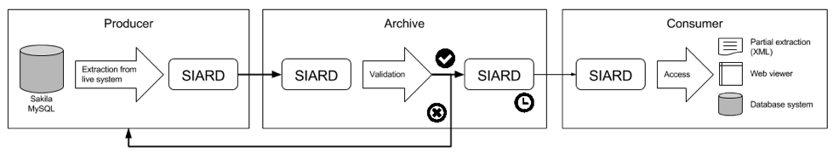
Scenario

Slide 2
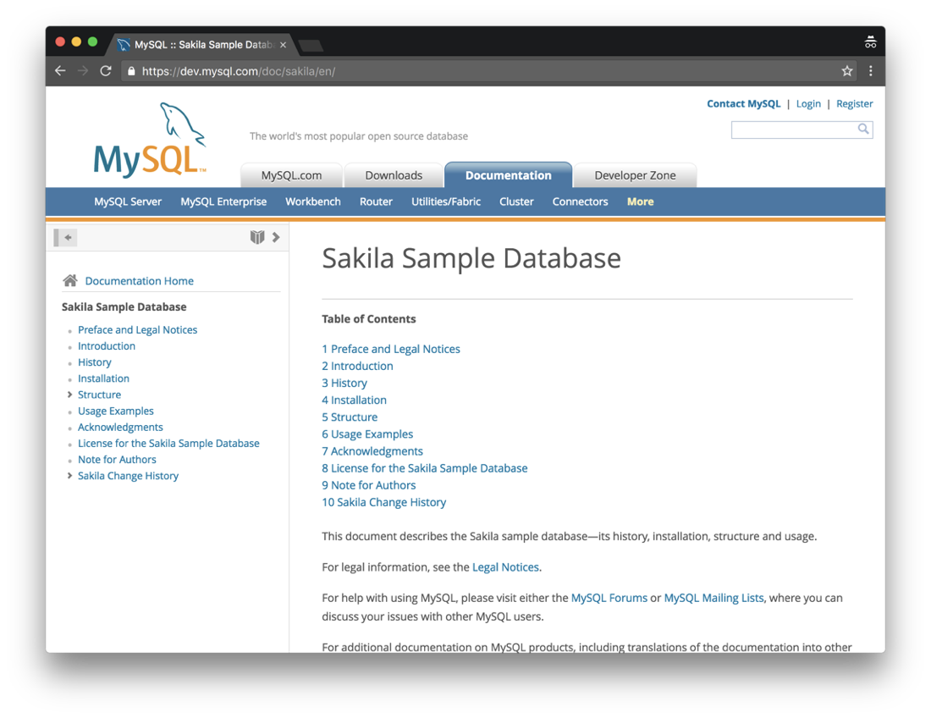

Slide 3
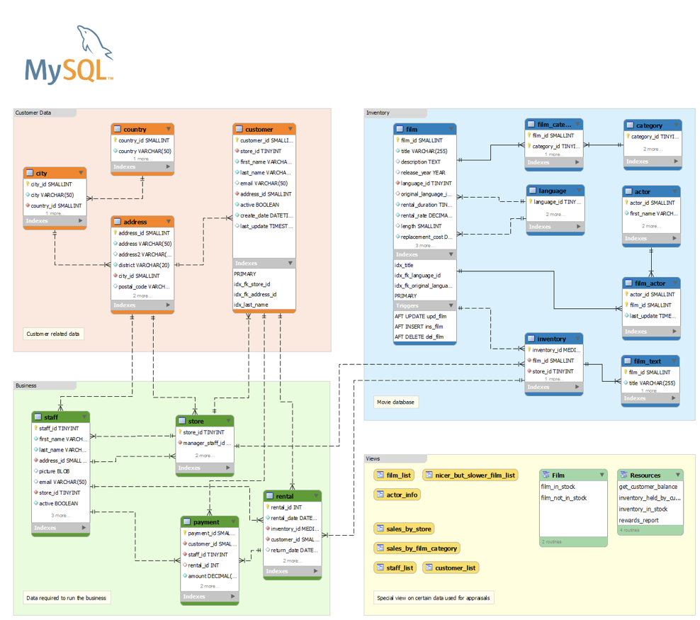

Slide 4


Slide 5
Database Preservation Toolkit
Pilots on:
Denmark National Archives
HungaryNational Archives
Estonia National Archives
Slovenia National Archives
Tested also on:
U.S. National Archives
Portuguese National Archives

Slide 6
Database Preservation Toolkit
Performance:
+50GB database in less than 1.5 hours
+40k rows/s
+10 MB/s
Quality: completeness and correctness
Roundtrip tests
SIARD validation

Slide 7
Database Visualization Toolkit
ROADMAP
Materialize views
Entity-relationship diagram
Facets: sum, average, max, min
Authentication
Multi-language
Printing

